Slide 1
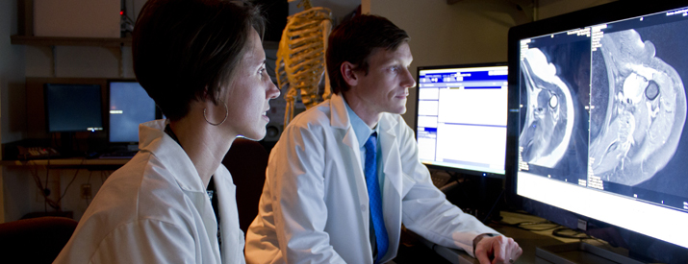
Musculoskeletal radiology

Slide 2


QUICK SUMMARY OF OUR WORK
USED:
Machine Learning
Python
Tableau
Flask
Pandas
Keras
Used a convolutional neural network to detect and localize.
Predicts the probability of abnormality.

Slide 3
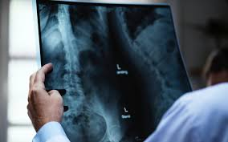
ABOUT OUR SOURCE
Stanford dataset of x-rays
Studies were manually labeled by radiologists as either normal or abnormal.
Source https://stanfordmlgroup.github.io/competitions/mura/
Notes:
https://stanfordmlgroup.github.io/competitions/mura/

Slide 4
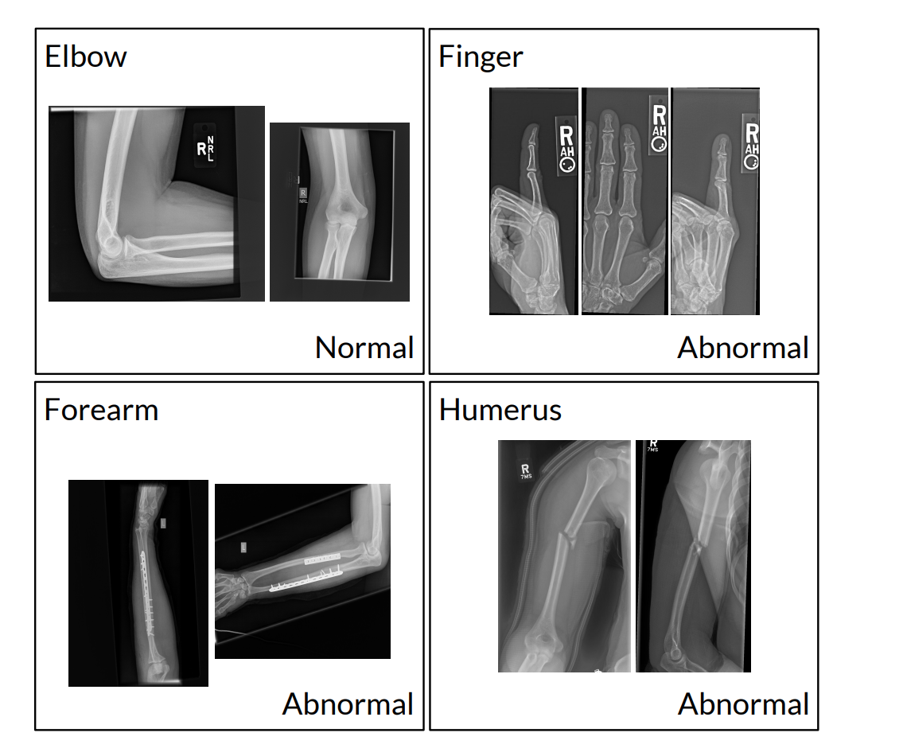
WHY AUTOMATED ABNORMALITY LOCALIZATION?
Allows the most injured patients to receive quicker diagnosis and treatment.
For the examinations who identified as normal can be properly triaged as lower priority on a worklist.

Slide 5
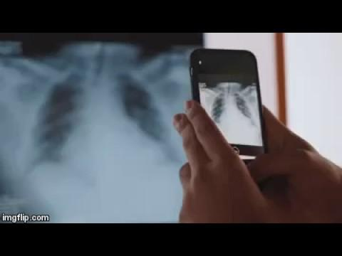
OUR IDEA
Facilitates x-ray screening
Diminish human error
Gives ability to diminish cost

Slide 6
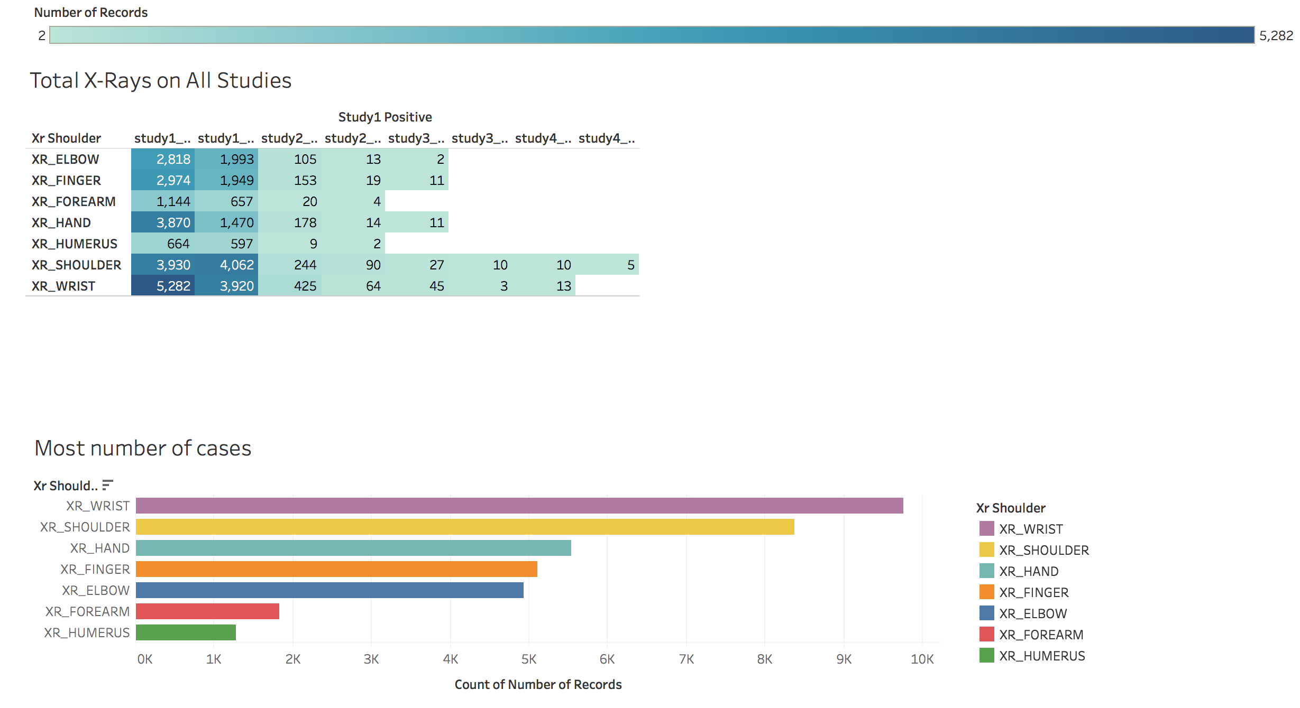
SUMMARY OF OVER ALL STUDIES

Slide 7
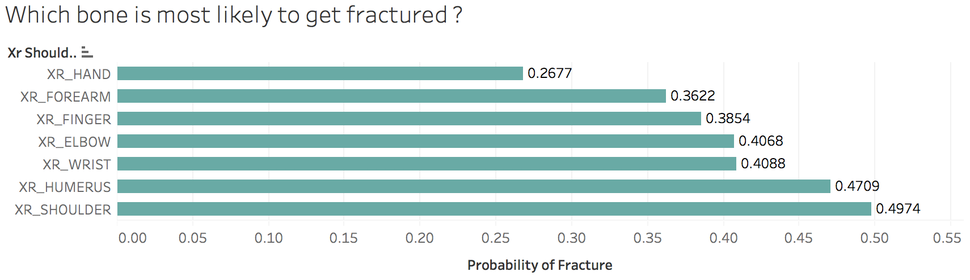
PROBABILITY

Slide 8
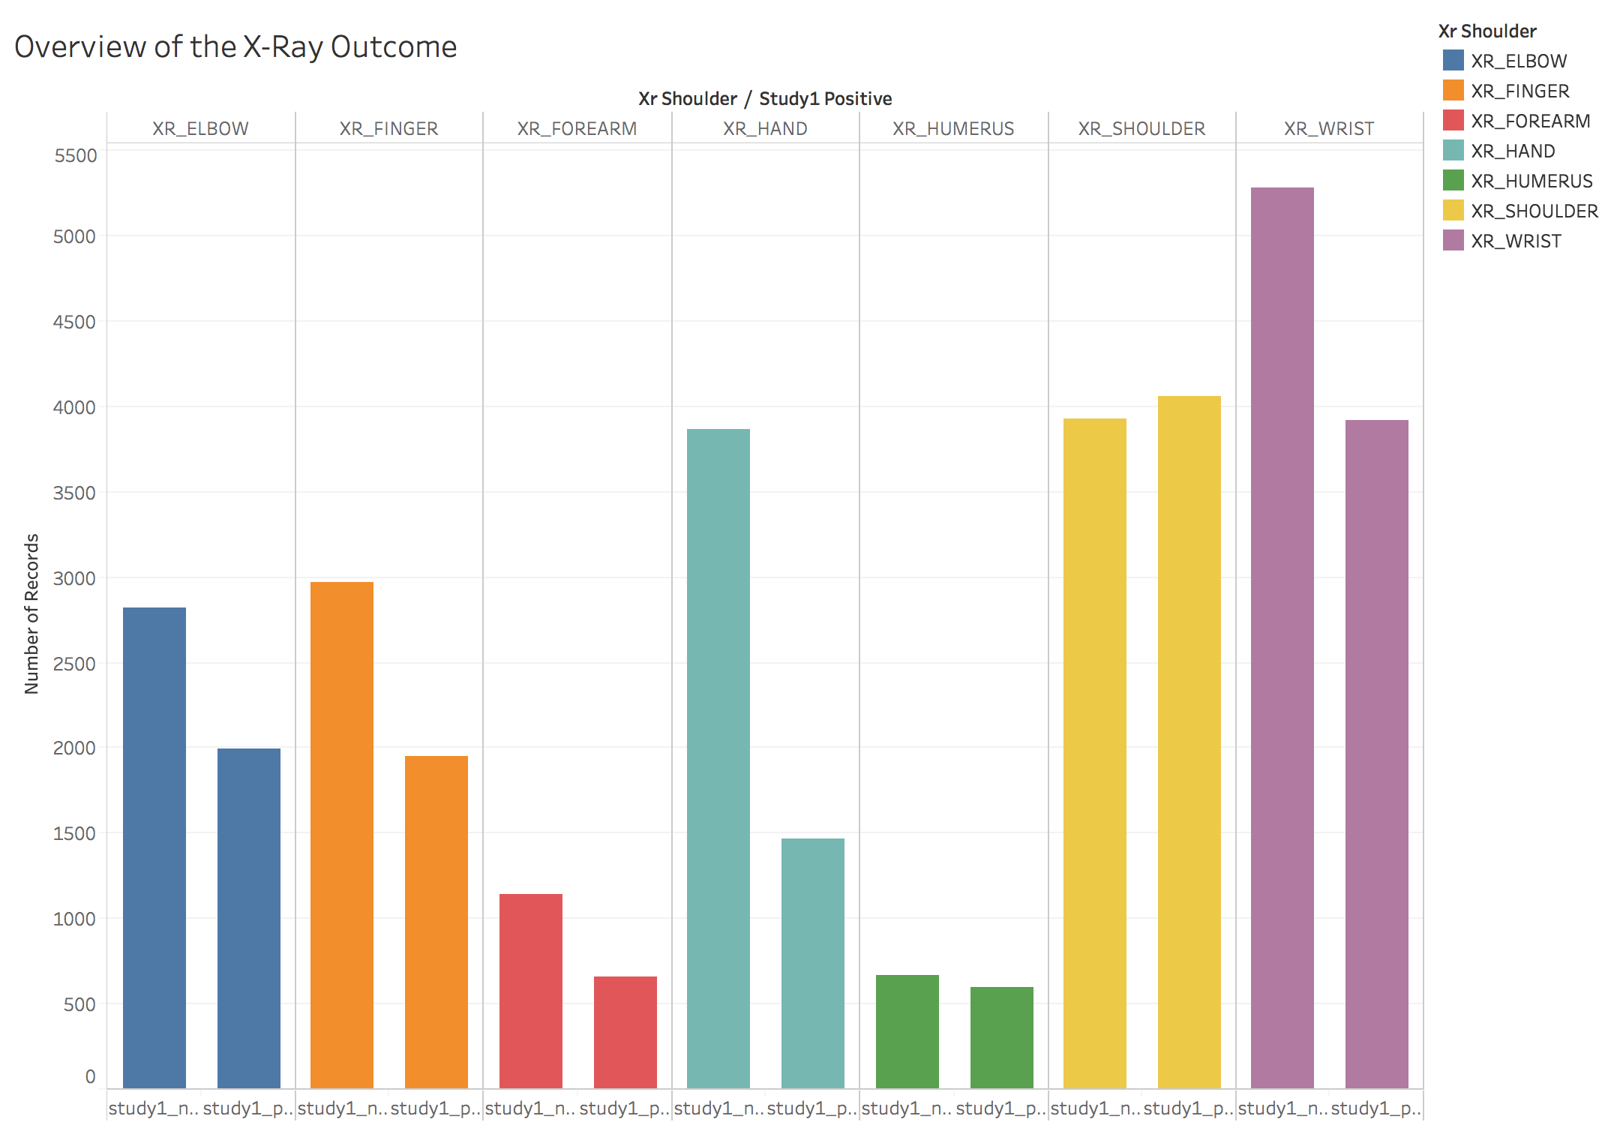
STUDY ONE

